Slide 1
Restaurant Management Web Application
TEAM P.W.D

Slide 2
Members
Nguyễn Thanh Việt
Nguyễn Phạm Đình Khang
Nguyễn Văn Hiệp
Đỗ Minh Tâm
Bùi Ngọc Danh

Slide 3

Project’s Requirement
I
Ingredients Management
Create & Save data into Ingredients Entity
II
Foods & Food Types Management
Create & Save data into Foods, Foodtypes & Food Details Entity
III
IV
Import Bill & Bill Manangement
Create & Save data into (Customers, Staffs, JobTitles, Tables, Import Bills & Details, Export Bills & Details, Suppliers) Entity
Menu Manangement
Create & Save data into Menus & Menu Details Entity

Slide 4
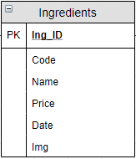
I
Ingredients Management
Create & Save data into Ingredients Entity

Slide 5
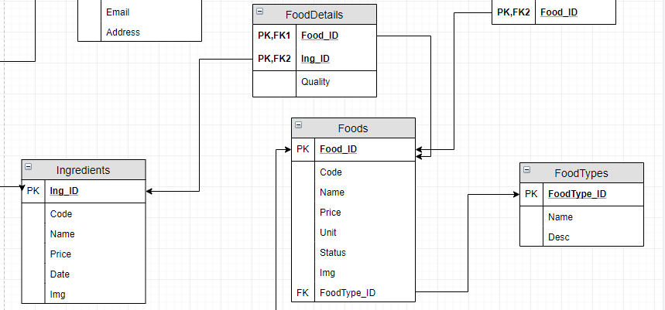
II
Foods & Food Types Management
Create & Save data into Foods, Foodtypes & Food Details Entity

Slide 6
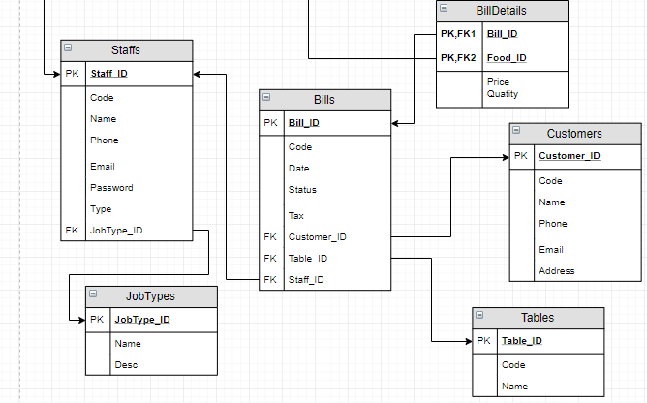
III
Import Bill & Bill Manangement
Create & Save data into (Customers, Staffs, JobTitles, Tables, Import Bills & Details, Export Bills & Details, Suppliers) Entity

Slide 7
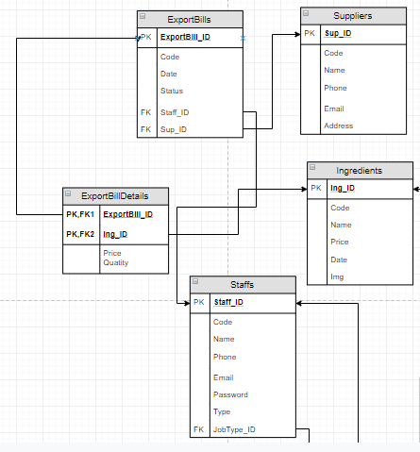
III
Import Bill & Bill Manangement
Create & Save data into (Customers, Staffs, JobTitles, Tables, Import Bills & Details, Export Bills & Details, Suppliers) Entity

Slide 8
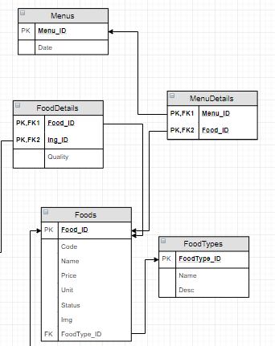
IV
Menu Manangement
Create & Save data into Menus & Menu Details Entity

Slide 9
Thank you for listening

